Slide 1

AWS SERVICES
LEARNING MAP
Media • AI/ML & Analytics • Management • Migration • Engagement • IoT • Developer Tools
Instructor-ready teaching deck | Prem Vishnoi
Notes:
[Sources] - AWS Overview of services: https://docs.aws.amazon.com/whitepapers/latest/aws-overview/introduction.html - Visual on this slide was generated with Microsoft Copilot.

Slide 2
01 | LEARNING STRATEGY
Remember outcomes, not long service lists
Process media
Turn data into intelligence
Encode, package, protect, personalize, and deliver video.
Prepare data, query it, train models, and create insights.
Operate the cloud
Move to AWS
Observe, audit, configure, automate, and govern.
Discover, assess, migrate, validate, and modernize.
Engage users
Build connected products
Contact centers, email, virtual desktops, and application streaming.
IoT, mobile backends, testing, and continuous delivery.
Notes:
[Sources] - Teaching structure synthesized from user-provided topics and AWS service documentation.

Slide 3
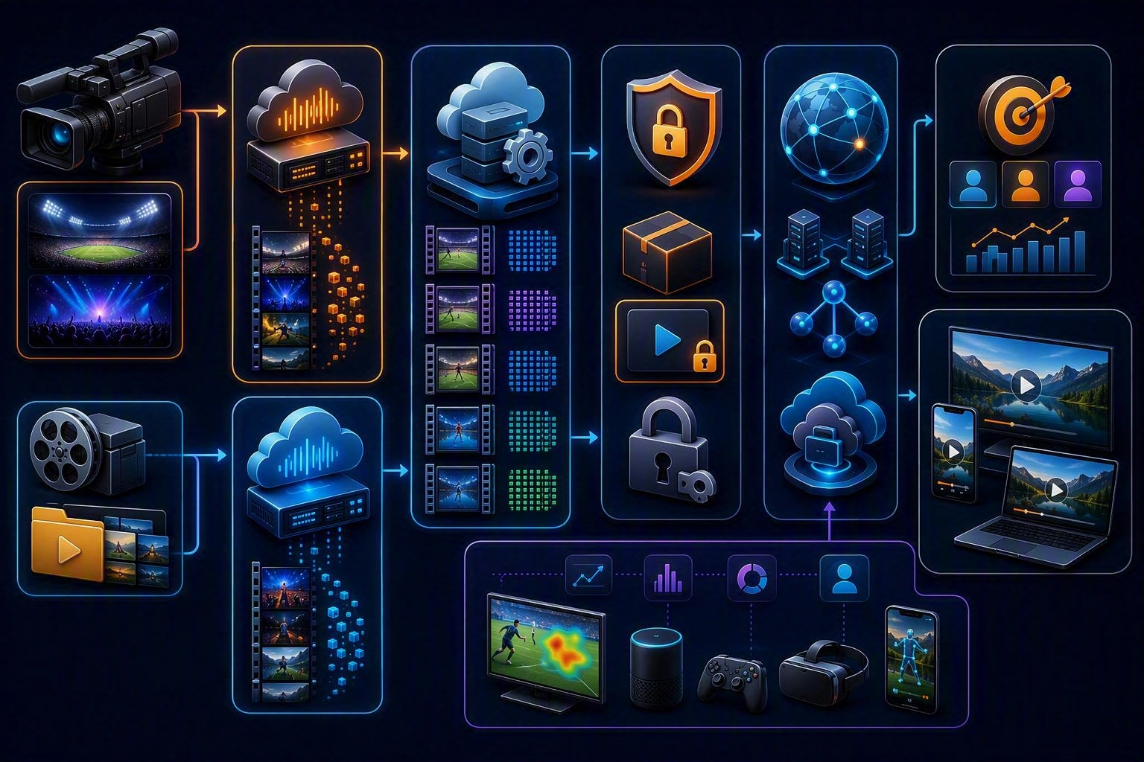
02 | MEDIA SERVICES
Modern video pipeline
Live
MediaLive encodes live inputs. MediaPackage prepares and protects streams for delivery.
On demand
MediaConvert transcodes stored media files into delivery formats.
Personalize and analyze
MediaTailor supports personalized ad insertion. Kinesis Video Streams ingests device video for processing and analytics.
Notes:
[Sources] - AWS media services overview: https://aws.amazon.com/media-services/ - Visual on this slide was generated with Microsoft Copilot.

Slide 4
03 | MEDIA SELECTION
Choose by media stage
Kinesis Video Streams
AWS Elemental MediaLive
Secure ingestion from connected devices for playback, analytics, and ML.
Broadcast-grade live video encoding.
AWS Elemental MediaPackage
AWS Elemental MediaConvert
Origin, package, and protect live or on-demand video.
File-based video transcoding for VOD and multiscreen delivery.
AWS Elemental MediaTailor
Amazon CloudFront
Personalized advertising and channel assembly.
Content delivery layer commonly used to reach viewers globally.
Notes:
[Sources] - AWS media services overview: https://aws.amazon.com/media-services/

Slide 5
04 | MEDIA MEMORY AID
L-F-P-A: Live, File, Package, Ads
●
LIVE encoding → AWS Elemental MediaLive.
●
FILE transcoding → AWS Elemental MediaConvert.
●
PACKAGE and protect → AWS Elemental MediaPackage.
●
ADS and personalization → AWS Elemental MediaTailor.
●
Device VIDEO ingestion and analytics → Kinesis Video Streams.
Do not teach “MediaTranscoder” as a separate AWS service. Transcoding is performed by services such as MediaConvert.
Notes:
[Sources] - AWS media services overview: https://aws.amazon.com/media-services/

Slide 6
05 | MEDIA UPDATE
Legacy transcoding material must be modernized
Amazon Elastic Transcoder
AWS Elemental MediaConvert
Historical file-transcoding service. AWS announced discontinuation effective November 13, 2025.
Current file-based transcoding service with modern codecs, broadcast-grade features, and scalable VOD workflows.
Teaching update: demonstrate MediaConvert, not Elastic Transcoder.
Notes:
[Sources] - AWS notice, November 12, 2024: https://aws.amazon.com/blogs/media/support-for-amazon-elastic-transcoder-ending-soon/

Slide 7
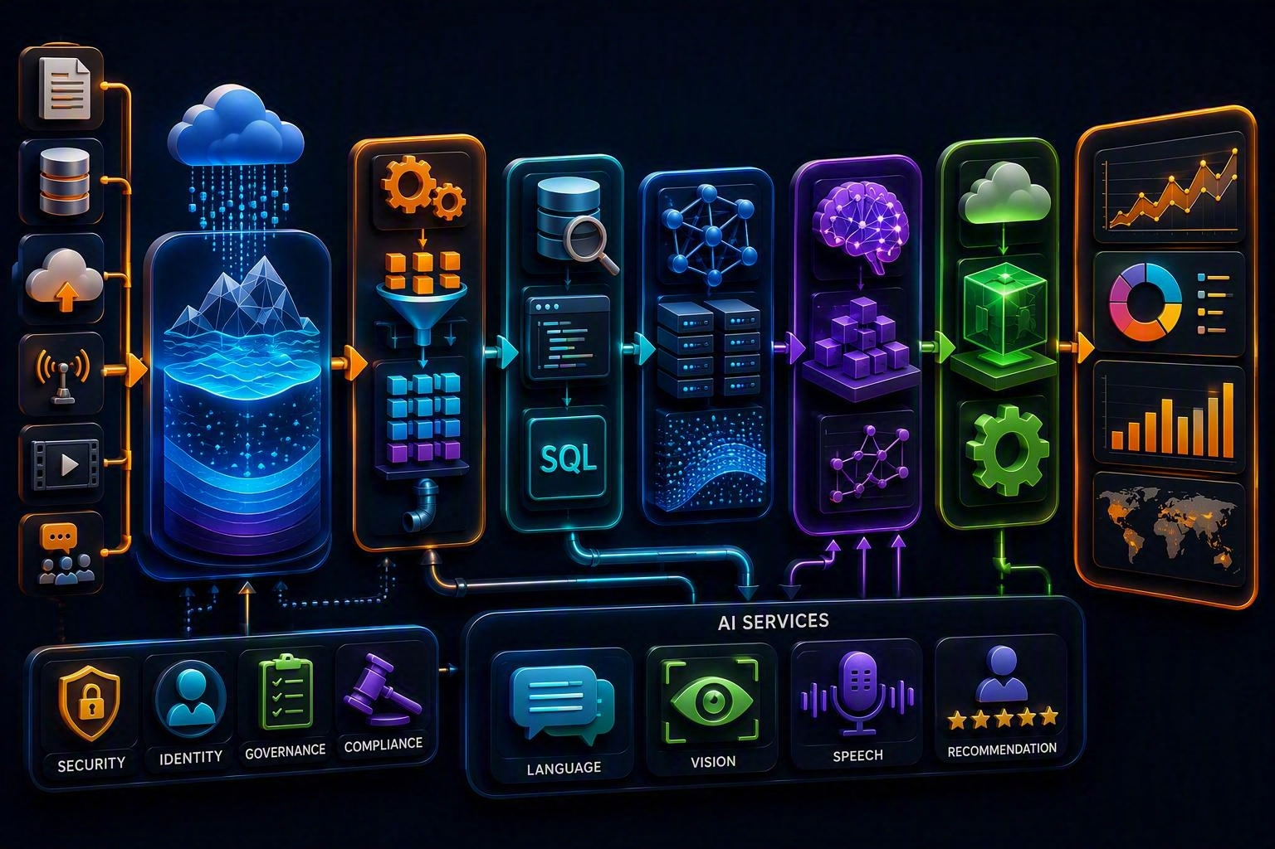
06 | AI AND ANALYTICS
From raw data to decisions
Data foundation
S3 stores data; Glue discovers, prepares, moves, and integrates it.
Analytics
Athena queries S3 with SQL; EMR runs big-data frameworks; QuickSight delivers BI.
Machine learning
SageMaker supports model development and deployment; AI services provide language, vision, and speech capabilities.
Notes:
[Sources] - AWS analytics overview: https://docs.aws.amazon.com/whitepapers/latest/aws-overview/analytics.html - AWS machine learning overview: https://docs.aws.amazon.com/whitepapers/latest/aws-overview/machine-learning.html - Visual on this slide was generated with Microsoft Copilot.

Slide 8
07 | AI SERVICES
Prebuilt AI vs. custom machine learning
Amazon SageMaker AI
Amazon Polly
Build, train, tune, and deploy machine-learning models.
Convert text into speech.
Amazon Translate
Amazon Comprehend
Neural machine translation.
Natural-language processing for insights from text.
Amazon Rekognition
Amazon Transcribe
Analyze images and videos for supported visual features.
Convert speech to text.
Amazon Lex
Frameworks such as TensorFlow
Build conversational interfaces using speech recognition and language understanding.
Frameworks can run on AWS compute or managed ML environments; TensorFlow itself is not an AWS service.
Notes:
[Sources] - AWS machine learning overview: https://docs.aws.amazon.com/whitepapers/latest/aws-overview/machine-learning.html

Slide 9
08 | ANALYTICS SERVICES
Choose by the processing question
Amazon Athena
Amazon EMR
Serverless SQL analysis of data in Amazon S3 and supported data sources.
Managed big-data platform for frameworks such as Apache Spark and Hadoop.
Amazon QuickSight
AWS Glue
Business intelligence, dashboards, and visual analysis.
Serverless data integration, catalog, ETL, and preparation.
Amazon Redshift
Amazon Kinesis Data Streams
Cloud data warehouse for analytical SQL.
Real-time ingestion of streaming data.
Notes:
[Sources] - AWS analytics overview: https://docs.aws.amazon.com/whitepapers/latest/aws-overview/analytics.html

Slide 10
09 | ANALYTICS DECISION
Memory model: Query, Process, Prepare, Visualize
●
Query S3 directly with SQL → Athena.
●
Process very large data with Spark or Hadoop → EMR.
●
Prepare, catalog, and integrate data → Glue.
●
Build dashboards for business users → QuickSight.
●
Create a managed analytical warehouse → Redshift.
●
Ingest event streams continuously → Kinesis Data Streams.
Notes:
[Sources] - AWS analytics overview: https://docs.aws.amazon.com/whitepapers/latest/aws-overview/analytics.html

Slide 11
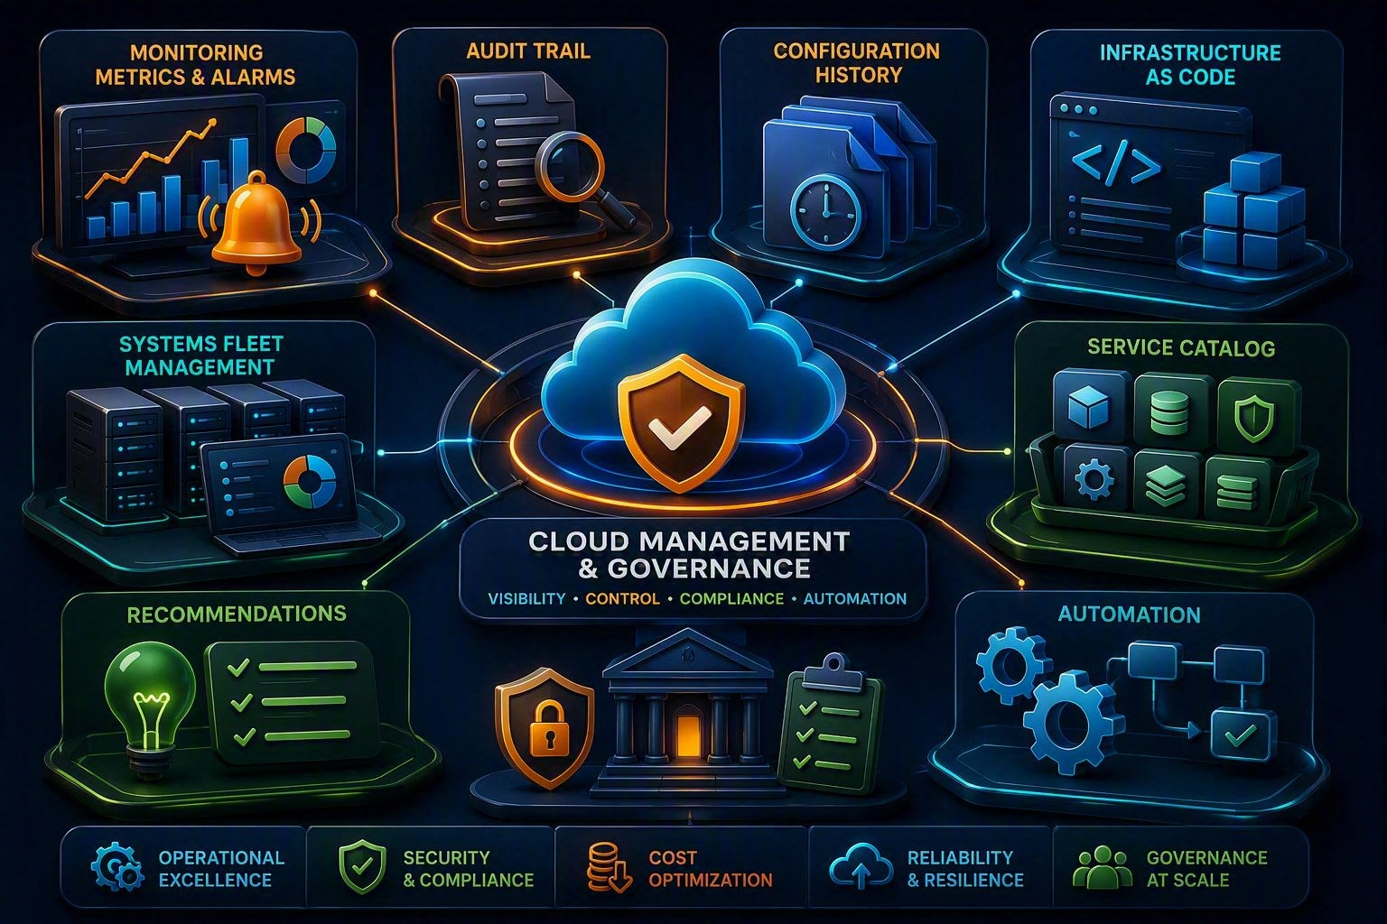
10 | MANAGEMENT TOOLS
Observe, audit, configure, automate, govern
Observe
CloudWatch provides metrics, logs, alarms, dashboards, and operational visibility.
Audit and configure
CloudTrail records account activity; AWS Config records resource configuration changes and evaluates rules.
Automate and govern
CloudFormation, Systems Manager, Service Catalog, and Trusted Advisor support repeatability and control.
Notes:
[Sources] - AWS management and governance overview: https://docs.aws.amazon.com/whitepapers/latest/aws-overview/management-and-governance.html - Visual on this slide was generated with Microsoft Copilot.

Slide 12
11 | OPERATIONS COMPARISON
CloudWatch vs. CloudTrail vs. Config
Amazon CloudWatch
AWS CloudTrail
AWS Config
Question: Is the system healthy?
Signals: metrics, logs, alarms, dashboards, traces, and events.
Question: Who did what, where, and when through AWS APIs and account activity?
Question: What configuration existed, how did it change, and does it meet configured rules?
Notes:
[Sources] - AWS management and governance overview: https://docs.aws.amazon.com/whitepapers/latest/aws-overview/management-and-governance.html

Slide 13
12 | AUTOMATION AND GOVERNANCE
Create repeatable and controlled environments
AWS CloudFormation
AWS Systems Manager
Model and provision infrastructure using templates.
Manage nodes and operational tasks such as automation, inventory, parameters, and patching.
AWS Service Catalog
AWS Trusted Advisor
Curate and distribute approved cloud products.
Recommendations across cost, performance, security, fault tolerance, and service limits.
AWS OpsWorks
Infrastructure as code principle
Configuration-management service associated with Chef and Puppet; treat as legacy-oriented content.
Store templates in version control, review changes, and deploy consistently.
Notes:
[Sources] - AWS management and governance overview: https://docs.aws.amazon.com/whitepapers/latest/aws-overview/management-and-governance.html

Slide 14

13 | MIGRATION
Discover, plan, move, validate, modernize
Discover and assess
Application Discovery Service gathers server information and dependencies. Migration Hub provides tracking and visibility.
Move workloads and data
AWS Application Migration Service rehosts servers; AWS DMS migrates databases; DataSync moves file and object data.
Modernize and optimize
Select rehost, replatform, or refactor based on business constraints, then validate and optimize after cutover.
Notes:
[Sources] - AWS migration and transfer overview: https://docs.aws.amazon.com/whitepapers/latest/aws-overview/migration-services.html - Visual on this slide was generated with Microsoft Copilot.

Slide 15
14 | MIGRATION SERVICE MAP
Choose based on what must move
AWS Migration Hub
AWS Application Discovery Service
Track migrations and gain a consolidated view.
Inventory servers and collect dependency and utilization information.
AWS Application Migration Service
AWS Database Migration Service
Rehost physical, virtual, or cloud servers to AWS.
Migrate databases while minimizing source downtime for supported scenarios.
AWS DataSync
AWS Transform
Move file and object data between storage systems.
Modernization and migration capabilities for supported workloads and programs.
Notes:
[Sources] - AWS migration and transfer overview: https://docs.aws.amazon.com/whitepapers/latest/aws-overview/migration-services.html - AWS migration decision guide, updated October 16, 2025: https://docs.aws.amazon.com/decision-guides/latest/decision-guides/migration-on-aws-how-to-choose.html

Slide 16
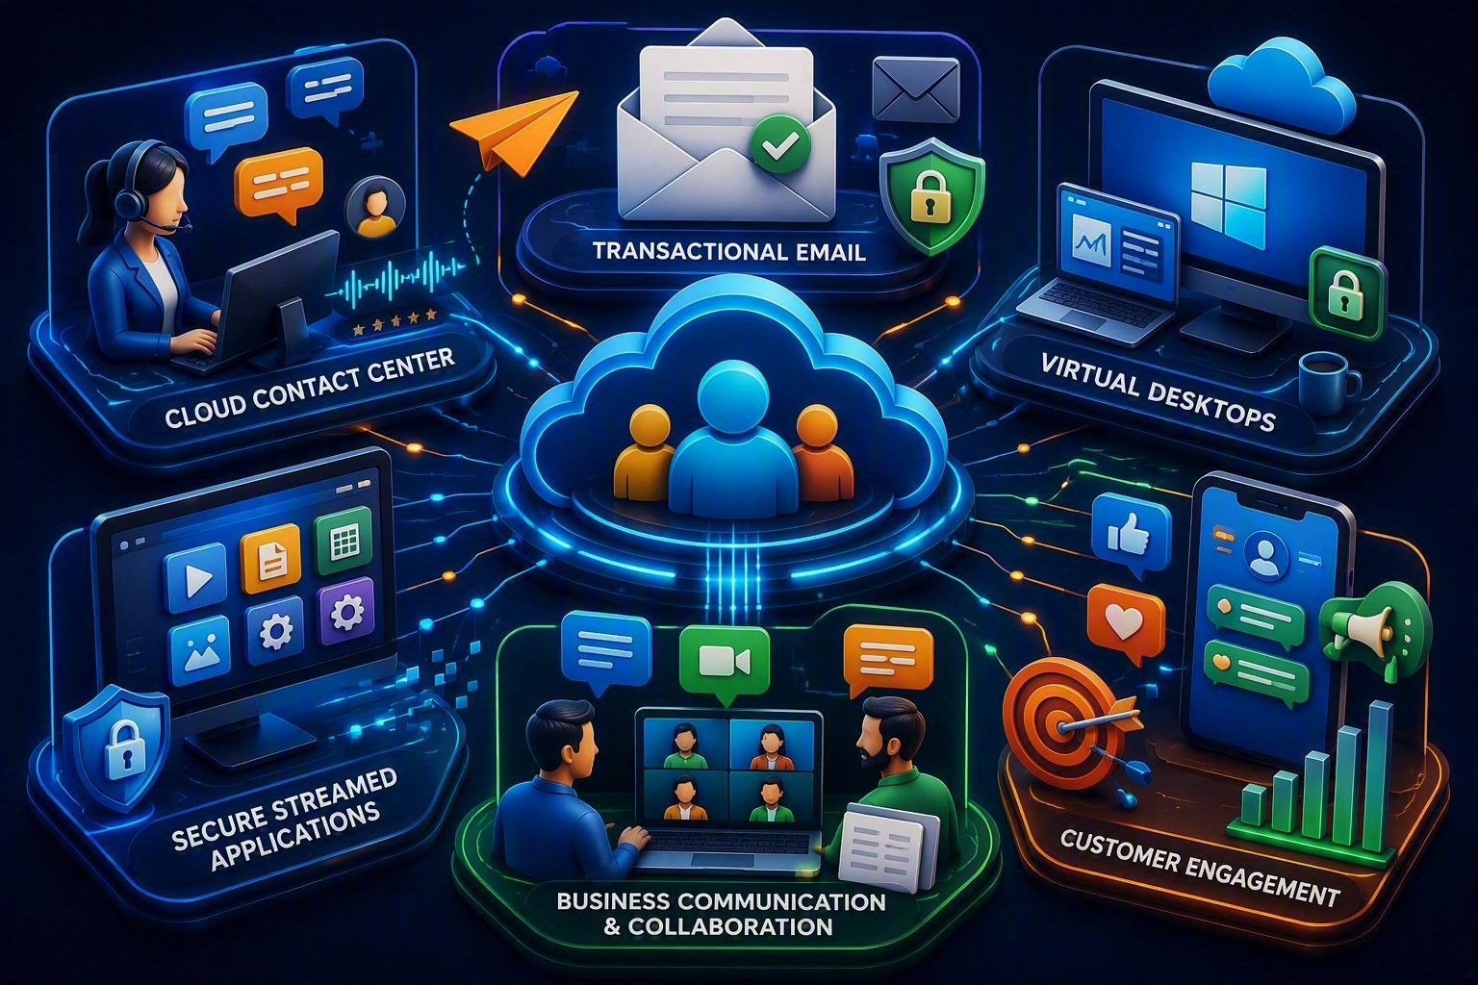
15 | CUSTOMER ENGAGEMENT
Serve customers and distributed workforces
Engage
Amazon Connect provides cloud contact-center capabilities; Amazon SES sends email.
Deliver desktops and apps
Amazon WorkSpaces provides virtual desktops; AppStream 2.0 streams desktop applications.
Collaborate carefully
Some older collaboration services in legacy course notes have changed status. Teach current service availability instead of equivalence claims.
Notes:
[Sources] - AWS business applications overview: https://docs.aws.amazon.com/whitepapers/latest/aws-overview/business-applications.html - AWS end user computing overview: https://docs.aws.amazon.com/whitepapers/latest/aws-overview/end-user-computing.html - Visual on this slide was generated with Microsoft Copilot.

Slide 17
16 | ENGAGEMENT DECISION
Match the user experience
Amazon Connect
Amazon SES
Cloud contact center and customer-service interactions.
Transactional, marketing, and bulk email delivery.
Amazon Pinpoint
Amazon WorkSpaces
Customer engagement through supported channels and segmentation capabilities.
Managed virtual desktop experience.
Amazon AppStream 2.0
Amazon Chime SDK
Stream individual desktop applications to users.
Add real-time communication capabilities to applications; distinguish it from legacy meeting-product descriptions.
Notes:
[Sources] - AWS business applications overview: https://docs.aws.amazon.com/whitepapers/latest/aws-overview/business-applications.html - AWS end user computing overview: https://docs.aws.amazon.com/whitepapers/latest/aws-overview/end-user-computing.html

Slide 18
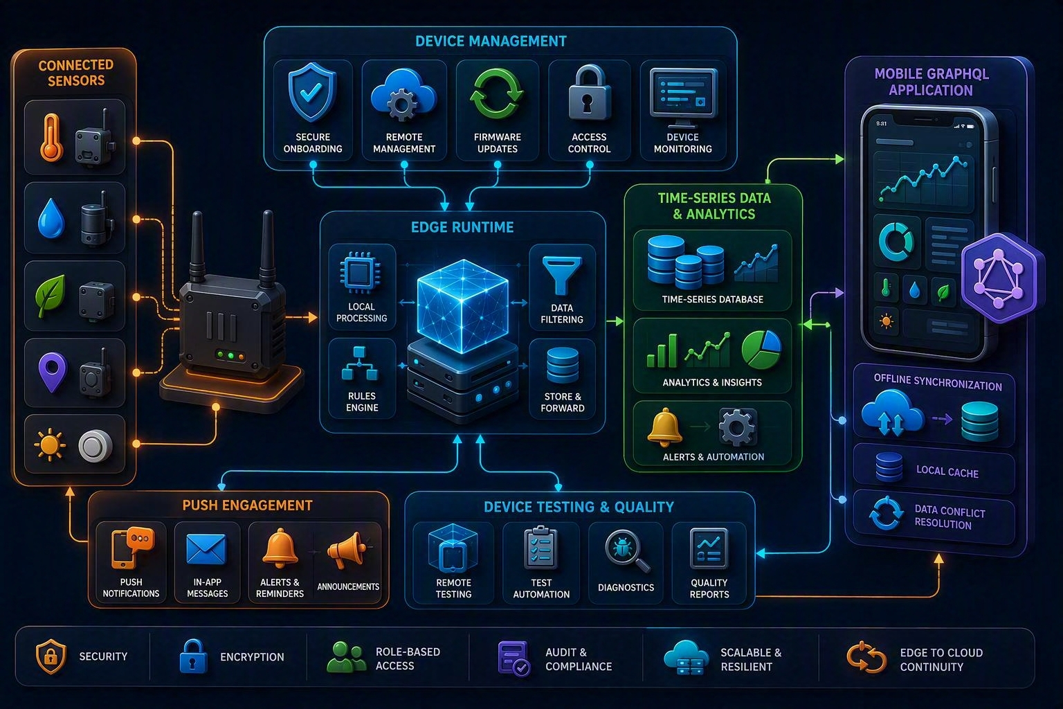
17 | IoT, MOBILE, AND EDGE
Connect devices and applications securely
IoT fleet
AWS IoT Device Management helps onboard, organize, monitor, and remotely manage device fleets.
Edge runtime
AWS IoT Greengrass extends cloud capabilities to edge devices for local processing and messaging.
Mobile backend
AWS AppSync provides managed GraphQL APIs and real-time/offline data patterns; Device Farm tests applications on devices.
Notes:
[Sources] - AWS IoT overview: https://docs.aws.amazon.com/whitepapers/latest/aws-overview/internet-of-things-services.html - AWS mobile services overview: https://docs.aws.amazon.com/whitepapers/latest/aws-overview/mobile-services.html - Visual on this slide was generated with Microsoft Copilot.

Slide 19
18 | IoT AND MOBILE MAP
Use current names and responsibilities
AWS IoT Device Management
FreeRTOS
Onboard, organize, monitor, and remotely manage devices.
Open-source real-time operating system for microcontrollers with cloud connectivity libraries.
AWS IoT Greengrass
AWS AppSync
Run local compute, messaging, and data processing at the edge.
Managed GraphQL APIs with real-time and offline synchronization capabilities.
AWS Device Farm
Amazon Pinpoint
Test mobile and web applications across browsers and physical devices.
Engagement campaigns and targeted messaging for supported channels.
Notes:
[Sources] - AWS IoT overview: https://docs.aws.amazon.com/whitepapers/latest/aws-overview/internet-of-things-services.html - AWS mobile services overview: https://docs.aws.amazon.com/whitepapers/latest/aws-overview/mobile-services.html

Slide 20
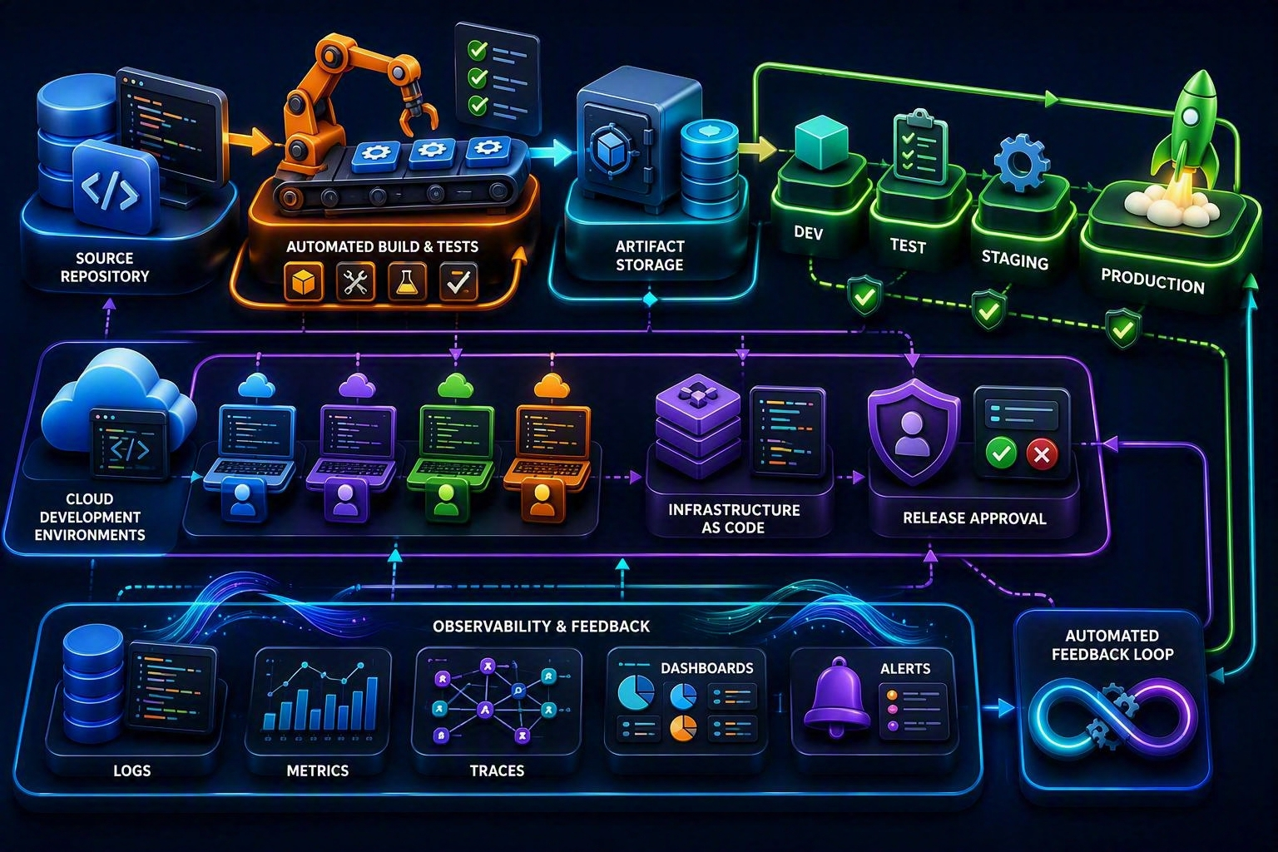
19 | DEVELOPER TOOLS
Source → Build → Test → Deploy → Observe
Build and release
CodeBuild builds and tests. CodeDeploy automates deployments. CodePipeline orchestrates release stages.
Observe
AWS X-Ray helps analyze distributed application requests and service dependencies.
Develop
Use supported IDEs, AWS Toolkits, CloudShell, and developer environments appropriate to the team.
Notes:
[Sources] - AWS developer tools overview: https://docs.aws.amazon.com/whitepapers/latest/aws-overview/developer-tools.html - Visual on this slide was generated with Microsoft Copilot.

Slide 21
20 | CI/CD SERVICE MAP
Understand each pipeline responsibility
Source repository
AWS CodeBuild
GitHub, GitLab, Bitbucket, or another supported source provider.
Compile source code, run tests, and produce artifacts.
AWS CodeDeploy
AWS CodePipeline
Automate deployments to supported compute targets.
Model and automate software release workflow stages.
AWS X-Ray
AWS CloudFormation / CDK
Trace requests and investigate service performance and errors.
Define and deploy infrastructure as code.
Notes:
[Sources] - AWS developer tools overview: https://docs.aws.amazon.com/whitepapers/latest/aws-overview/developer-tools.html

Slide 22
21 | MODERNIZATION ALERT
Several legacy course items require replacement or qualification
●
Amazon Elastic Transcoder support ended November 13, 2025 → teach MediaConvert.
●
“MediaTranscoder” is not a distinct AWS service → use MediaConvert for file transcoding.
●
AWS Data Pipeline is unavailable to new customers → prefer Glue, Step Functions, or Amazon MWAA based on requirements.
●
TensorFlow is an open-source framework, not an AWS managed service.
●
AWS CodeCommit and AWS Cloud9 closed new-customer access on July 25, 2024; existing customers can continue using them.
●
Avoid teaching Mobile Hub, Mobile Analytics, or Sumerian as default current choices without verifying service status and alternatives.
●
Server Migration Service terminology is outdated → teach AWS Application Migration Service.
Notes:
[Sources] - AWS Elastic Transcoder notice: https://aws.amazon.com/blogs/media/support-for-amazon-elastic-transcoder-ending-soon/ - AWS Data Pipeline migration guidance: https://docs.aws.amazon.com/datapipeline/latest/DeveloperGuide/migration.html - AWS service access update: https://aws.amazon.com/blogs/aws/this-week-in-aws-july-29-2024/

Slide 23
22 | ARCHITECTURE EXERCISE
Design a video analytics and engagement platform
Ingest
Process media
Kinesis Video Streams receives camera streams.
MediaLive handles live encoding; MediaConvert handles stored files.
Analyze
Store and query
Rekognition or custom SageMaker models analyze supported content.
S3 stores outputs; Glue catalogs; Athena queries.
Engage
Operate
Pinpoint or SES distributes supported notifications.
CloudWatch observes health; CloudTrail records activity; CloudFormation deploys infrastructure.
Notes:
[Sources] - Architecture exercise synthesized from cited AWS service descriptions.

Slide 24
23 | KNOWLEDGE CHECK
Choose the service from the requirement
Convert stored broadcast video into multiple VOD formats
Run SQL directly against data in S3
MediaConvert
Athena
Create dashboards for business users
Record who called an AWS API
QuickSight
CloudTrail
Move physical or virtual servers to AWS
Stream a desktop application through a browser
Application Migration Service
AppStream 2.0
Notes:
[Sources] - Knowledge-check questions created from cited AWS documentation.

Slide 25
24 | FINAL MEMORY MAP
Eight outcome phrases
MediaConvert
File video
MediaLive + MediaPackage
Live encode + package
SageMaker + AI services
Custom ML + prebuilt intelligence
Athena / Glue / EMR / QuickSight
Query / prepare / process / visualize
CloudWatch / CloudTrail / Config
Health / activity / configuration
MGN / DMS
Servers / databases
Connect / SES / WorkSpaces / AppStream
Contact / email / desktop / app
CodeBuild / CodeDeploy / CodePipeline / X-Ray
Build / deploy / orchestrate / trace
Remember the workload outcome first. Then choose the AWS service.
Notes:
[Sources] - Summary created from cited AWS documentation.

